Slide 1
Reading R&D Interests in Automotive Industry
- Text mining from patent documents
Jiho Kang
Roland Cs.
Zhao Jieying (presentor)
Sungjun Ahn (presentor)

Slide 2

Contents
1
Data Collection
2
Text Mining Initiation
3
Using TF / TF-IDF
4
Social Network Analysis
5
Map of Keywords
6
Result & Conclusion

Slide 3
Methodology
Data Collection
Using Textmining
Structured Data
Using TF/ TF-IDF
Keywords Extraction
Using Social Network Analysis
Map of Keywords
Comparing the Map
R&D Strategy

Slide 4




Data Collection
Limitations
No download options (wipo)
Time-intensive, inefficient search and download functions on Espacenet (e.g. no abstract)

Slide 5
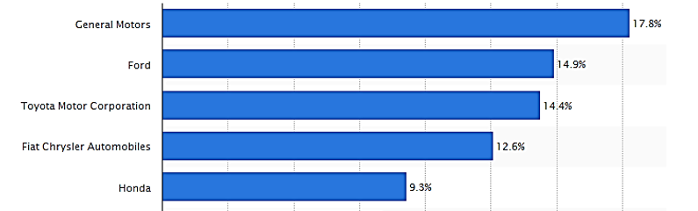
Data Collection
Choosing Target Companies
US Sales Volume as of 2014 Source: Statista 2015

Slide 6
Data Collection
Search Results
Search Formula
GM:
((car or cars or automobile or vehicle or (motor adj car))) AND (gm or (general adj motors)).AP.
Ford:
(((car or cars or automobile or vehicle or (motor adj car))) AND (ford adj motor).AP.)
Toyota:
(((car or cars or automobile or vehicle or (motor adj car))) AND (toyota adj motor).AP.)
Ford:
((car or cars or automobile or vehicle or (motor adj car))) AND (Chrysler).AP.
Honda:
(((car or cars or automobile or vehicle or (motor adj car))) AND (ford adj motor).AP.)
Notes:
GM GLOBAL TECHNOLOGY OPERATIONS LLC
Gm Global Technology Operations Inc was founded in 2009. The company's line of business includes providing professional engineering services.

Slide 7





Data Collection
Search Results - Data
Company | Raw data | Valid Data
 | 8,530 | 5,621
 | 838 | 700
 | 9,232 | 6,066
 | 566 | 450
 | 8,012 | 5,084
Notes:
GM GLOBAL TECHNOLOGY OPERATIONS LLC
Gm Global Technology Operations Inc was founded in 2009. The company's line of business includes providing professional engineering services.

Slide 8
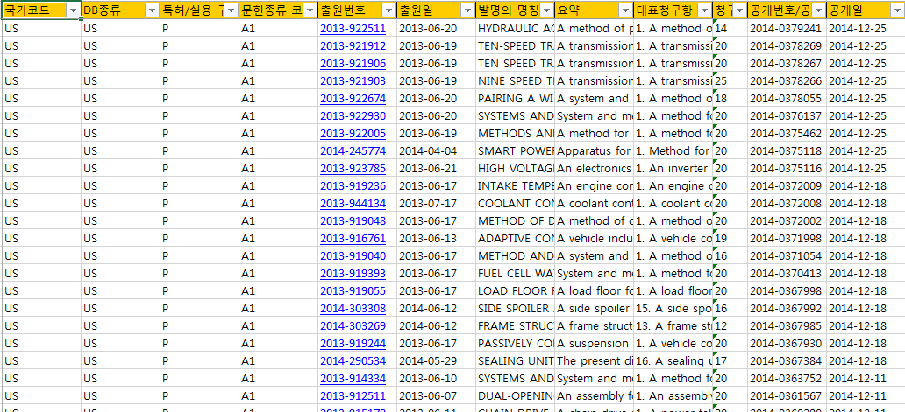
Text Mining Initiation
1st Data In XLSX File

Slide 9
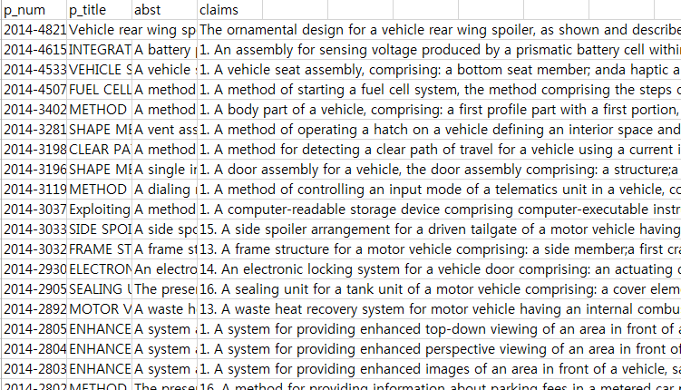
Text Mining Initiation
1st CSV File
Application number / date
Title, Abstract & Claim
of Invention

Slide 10
Text Mining Initiation
Text Mining & Preparing File
test.data<-read.csv("C:/R-files/gm.csv",head=T,sep=",")
test=paste(test.data[,2],test.data[,3],test.data[,4])
Preprocessing and stemming:
test=Corpus(VectorSource(test))
test=tm_map(test, stripWhitespace)
test=tm_map(test, content_transformer(tolower))
test=tm_map(test, removeWords, stopwords("english"))
test <- tm_map(test, content_transformer(removePunctuation))
test <- tm_map(test, content_transformer(removeNumbers))
test <- tm_map(test, stemDocument)
Notes:
Text mining:
#integrate data: title, abstract, and claim
A vector source interprets each element of the vector x as a document

Slide 11
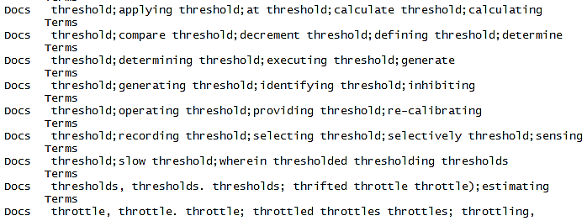
Text Mining Initiation
Corpus & DTM
Corpus
test.cor=Corpus(VectorSource(test)) # change to corpus
test.cor
Document-Term Matrix
test.dtm=DocumentTermMatrix(test.cor)
inspect(test.dtm)
Metadata: corpus specific 0, document level (indexed): 0 Content: documents: 6587

Slide 12
Using Term Frequency - TF-IDF
TF-IDF and normalized DTM
test.tfidf<-weightTfIdf(test.dtm, normalize=TRUE)
#weighting tf-idf to data
write.matrix(test.tfidf, "C:/R-files/tfidf.csv", sep=",")
write.matrix(test.dtm, "C:/R-files/dtm.csv", sep=",")
# both writing file (~900 MB TF-IDF and ~200 MB DTM)
Notes:
Text mining:
#integrate data: title, abstract, and claim
A vector source interprets each element of the vector xas a document

Slide 13
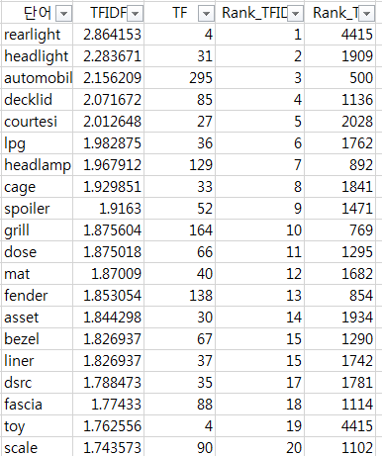
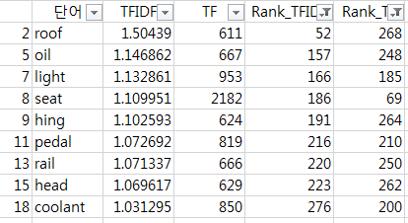
Using TF / TF-IDF
TF / TF-IDF
Top Keywords Extraction
Notes:
Text mining:
#integrate data: title, abstract, and claim
A vector source interprets each element of the vector xas a document

Slide 14
Keyword
GM
Ford
300
95
coolant, head, hing, light, oil, pedal, rail, roof ,seat, tube, window
servic, rate, speed, fuel, engine batteri, surface, side, bodi, roof, panel, door, taillight
200
Toyota
Chrysler
Honda
100
250
airbag, assist, display, door, heat, imag, oil, park, seat, steer
temperatur, pump, fuel, shift, door, automobile, wheel, brake, rear, seat
airbag, automobil, bumper, charg, display, imag, lid, light, rail, roof, throttl

Slide 15
Keyword Matrix
m Terms
A
n Docs
=
Keyword
Matrix
m
Terms
X
n
Docs
A^{T}
m X n Matrix
m X m Matrix
n X m Matrix

Slide 16


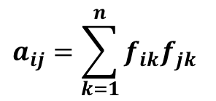
Keyword Matrix
 | Term 1 | Term 2 | Term 3
Term 1 | a₁₁ | a₁₂ | a₁₃
Term 2 | a₂₁ | a₂₂ | a₂₃
Term 3 | a₃₁ | a₃₂ | a₃₃
 | Doc 1 | Doc 2 | Doc 3
Term 1 | f₁₁ | f₁₂ | f₁₃
Term 2 | f₂₁ | f₂₂ | f₂₃
Term 3 | f₃₁ | f₃₂ | f₃₃
Keyword Matrix
Term-Doc Matrix
For term i and term j in n documents,
$$a_{11}={f_{11}}^{2}+{f_{22}}^{2}+{f_{22}}^{2}$$
$$a_{ij}=\sum_{k=1}^{n}{f_{ik}f_{jk}}$$
$$a_{12}=f_{11}f_{21}+f_{12}f_{22}+f_{13}f_{23}$$
$$f_{ik}:term frequency of term i in document k$$
$$f_{jk}:term frequency of term j in document k$$

Slide 17
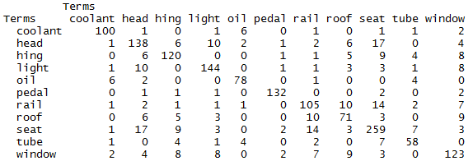
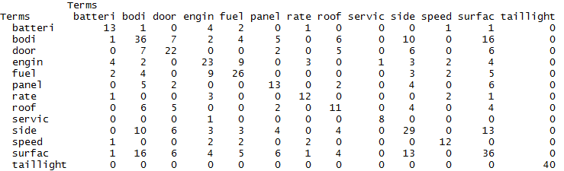
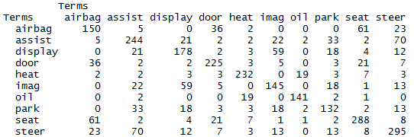
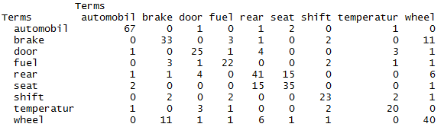
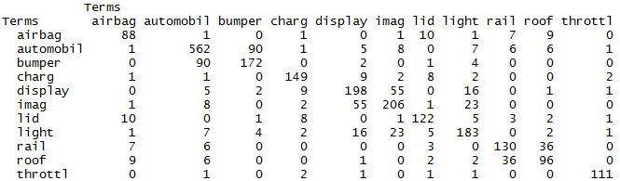
Keyword Matrix
GM
Ford
Toyota
Chrysler
Honda

Slide 18
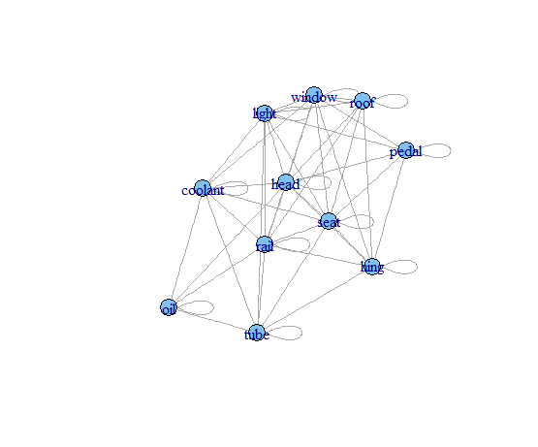
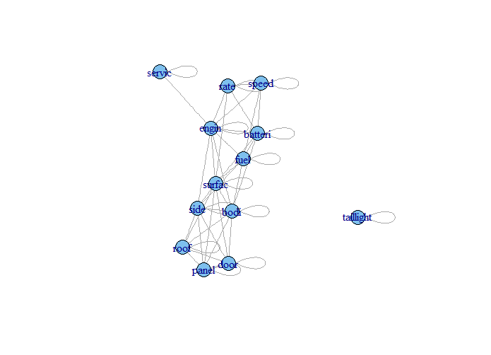
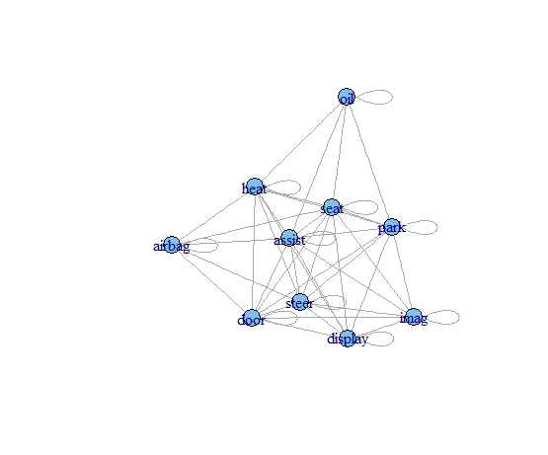
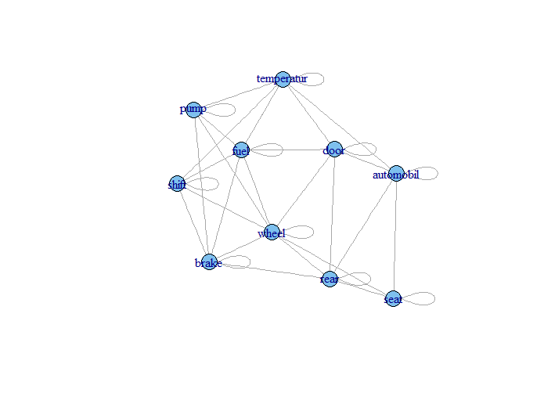
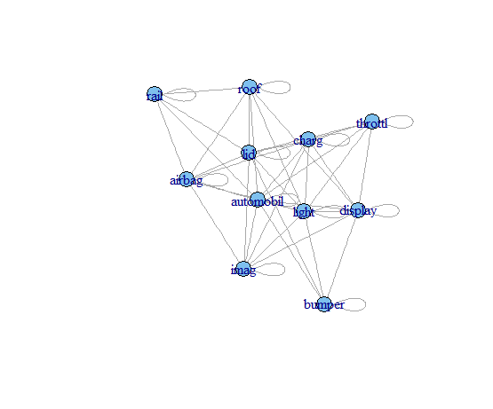
SNA(Social Network Analysis)
GM
Ford
Toyota
Chrysler
Honda

Slide 19

Result
Keyword Network Diagram of GM
GM
‘seat’ is considered the most frequently used among the extracted keywords
Strongly associated pairs: {seat, head}, {seat, rail}, {light, head}
Mutually exclusive pairs: {coolant, roof}, {head, tube}, {oil, light}, …

Slide 20
Result
Keyword Network Diagram of FORD
Ford
‘taillight’ is considered the most frequently used among the extracted keywords
Strongly associated pairs: {surface, bodi}, {surface, side}
Mutually exclusive pairs: {battery, roof}, {battery, service}, {door, engine}, …
Taillight is not associated with any other extracted keywords at all

Slide 21
Result
Keyword Network Diagram of TOYOTA
Toyota
‘steer’ is considered the most frequently used among the extracted keywords
Strongly associated pairs: {steer, airbag}, {seat, airbag}, {image, display}
Mutually exclusive pairs: {airbag, display}, {airbag, image}, {display, oil}, …

Slide 22
Result
Keyword Network Diagram of CHRYSLER
Chrysler
‘automobile’ is considered the most frequently used among the extracted keywords
Strongly associated pairs: {wheel, brake}, {wheel, rear}
Mutually exclusive pairs: {break, temperature}, {seat, fuel}, {shift, door}, …

Slide 23
Result
Keyword Network Diagram of HONDA
Honda
‘automobile’ is considered the most frequently used among the extracted keywords
Strongly associated pairs: {bumper, automobile}, {image, display}, {image, light}
Mutually exclusive pairs: {airbag, bumper}, {airbag, display}, {bumper, image}, …

Slide 24
Result
GM
Ford
coolant, head, hing, light, oil, pedal, rail, roof ,seat, tube, window
servic, rate, speed, fuel, engine batteri, surface, side, bodi, roof, panel, door, taillight
Toyota
Chrysler
Honda
airbag, assist, display, door, heat, imag, oil, park, seat, steer
temperatur, pump, fuel, shift, door, automobile, wheel, brake, rear, seat
airbag, automobil, bumper, charg, display, imag, lid, light, rail, roof, throttl

Slide 25
Result
GM
Ford
coolant, head, hing, light, oil, pedal, rail, roof ,seat, tube, window
servic, rate, speed, fuel, engine batteri, surface, side, bodi, roof, panel, door, taillight
Toyota
Chrysler
Honda
airbag, assist, display, door, heat, imag, oil, park, seat, steer
temperatur, pump, fuel, shift, door, automobile, wheel, brake, rear, seat
airbag, automobil, bumper, charg, display, imag, lid, light, rail, roof, throttl
Both TOYOTA and HONDA have research interests on {airbag, display, image}.
{roof, seat, door, fuel(~oil)} are common research interests among the companies.
Differentiated technological elements for each company
: GM → {coolant, pedal, tube}, Ford → {engine, taillight}, TOYOTA → {park, steer}, CHRYSLER → {pump, wheel, brake}, HONDA → {bumper, charge, throttle}

Slide 26
Result
When you have a plan to develop a new brake system, whose patents are you searching for?
Company | Differentiated Elements
GM | coolant, pedal, tube
FORD | engine, taillight
TOYOTA | park, steer
CHRYSLER | pump, wheel, brake
HONDA | bumper, charge, throttle

Slide 27
Conclusion
Conclusion
We extracted important keywords from the patent documents of the target companies (GM, Ford, Toyota, Chrysler, Honda) using text mining techniques.
Term frequency and TF-IDF were used for the criteria for determining the importance of keywords.
We found out the relationships between the extracted keywords using SNA.
We identified the common research interests among the target companies.
We identified the differentiated technological elements of each company.

Slide 28
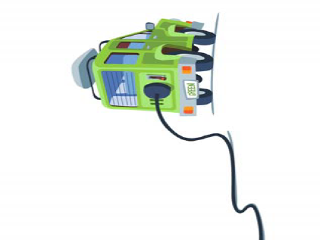
Thank you! Q&A

